Slide 1
DDS: Case Study 01
Beers and Breweries

Slide 2
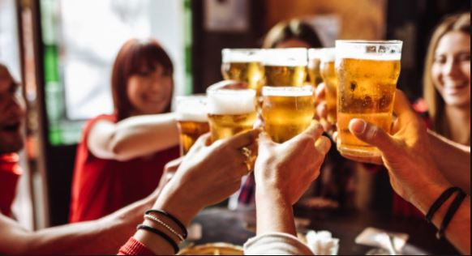
Data Provided
We were provided 2 datasets.
Taken together the data contain information on selected breweries in all 50 states of the United States.
It includes their respective beer products;
associated Alcohol by Volume;
International Bitterness Unit;
And their home cities and states.

Slide 3
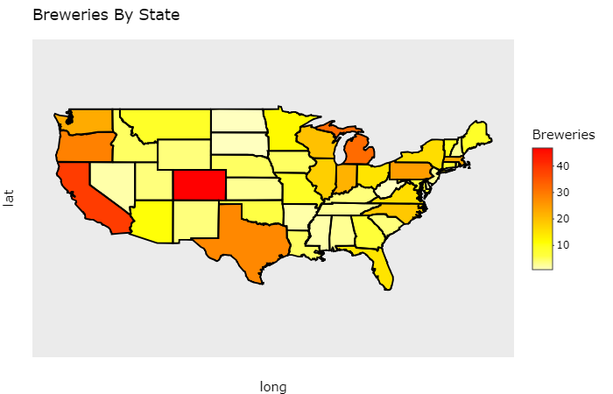
Top Three:
Colorado
California
Michigan
Least Three:
North Dakota
South Dakota
West Virginia

Slide 4
Resolved Missing Data
Predictive Mean Matching
filled in value matches the original density plot
Proceed to imputed data for further analysis

Slide 5
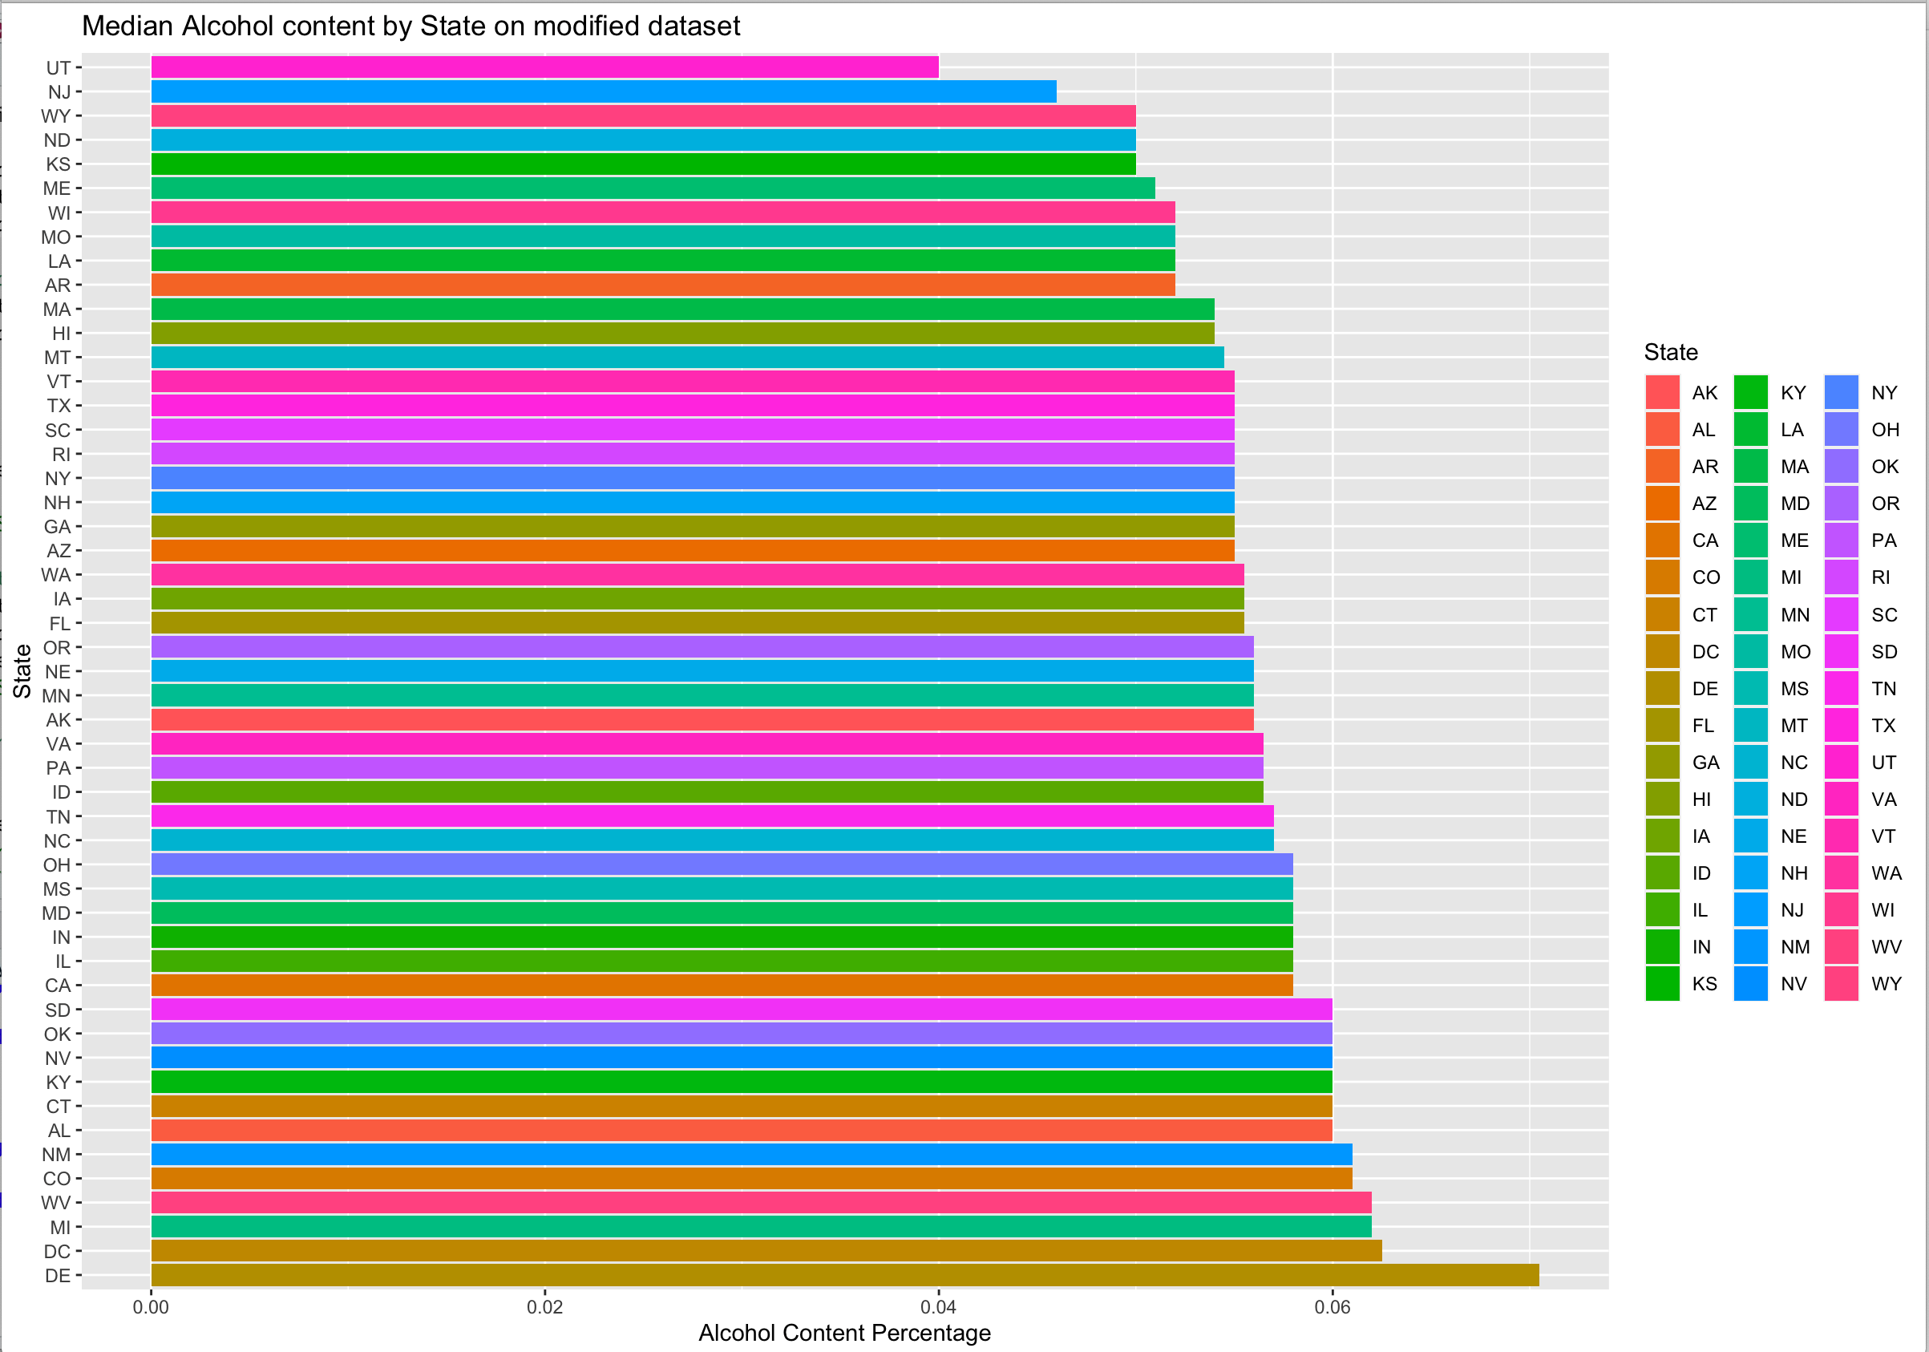
EDA: Median ABV by state
Highest two median ABV found:
Delaware
Washington DC
Michigan
Lowest two median ABV found:
Utah
New Jersey
Wyoming

Slide 6
EDA: Median IBU by state
Highest three median of IBU found:
Washington DC
Arkansas
New Hampshire
Lowest three median IBU found:
Wyoming
Wisconsin
Kansas

Slide 7


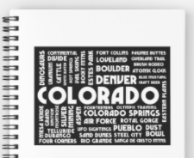

State with most alcholic Beer, and most bitter beer
Max alcoholic beer
Most Bitter beer

Slide 8
Summary Statistics for ABV:
ABV
Range from 0.1% to 12.8%
Median is 5.6%
Mean is 6%
Boxplot showing distribution of values.
Red stars are outliers
It is right-skewed distribution

Slide 9
This scatter plot shows a broad positive linear relationship between the alcohol content and bitterness of beer.
This relationship needs further investigation because it does not appear strong because high ABV also has low IBUs

Slide 10
KNN Classification by ABV and IBU
Value of k for optimal Accuracy = 9
Value of k for optimal Sensitivity > 37

Slide 11
Model Comparison
KNN Classification by ABV and IBU
Naïve Bayes model by ABV and IBU
Overall accuracy 0.8
Correctly predicting IPA 0.78
Correctly predicting Other Ales 0.81
Overall accuracy 0.78
Correctly predicting IPA 0.68
Correctly predicting Other Ales 0.85
Note: We can tune KNN to increase better prediction on either IPA or Other ales, we can’t tune Naïve Bayes model because it is using probabilities

Slide 12
Density of Ale producing Facilities

Slide 13
Average ABV by State

Slide 14
Density of Average ABV per City

Slide 15

www.hiclipart.com

